Slide 1



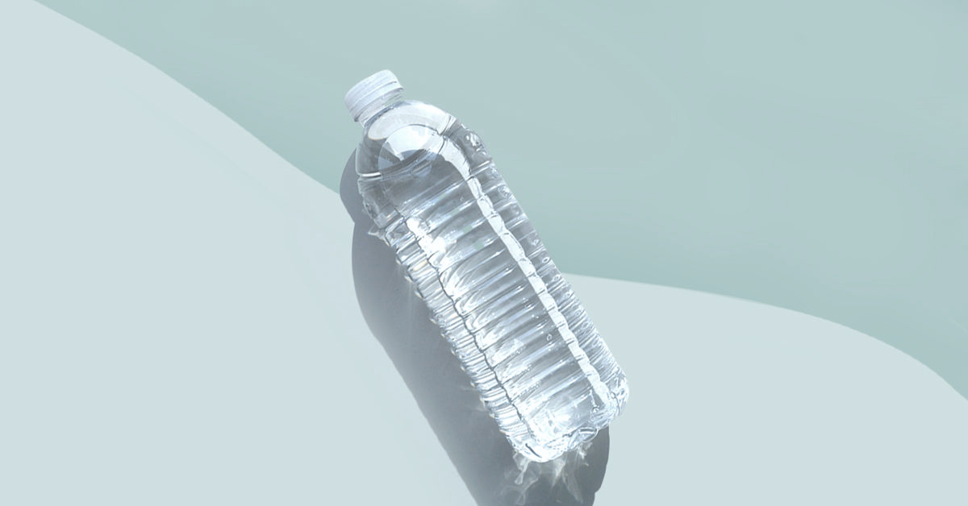

Bottled Mineral Water & Groundwater Quality Assessment in Europe
Group member: Zhiqi Wang, Jiaru Chang
Supervisor: Steven Eisenreich, Marc Elskens
Water Quality Assessment
04.05.2021
Photograph by Jennifer Still

Slide 2
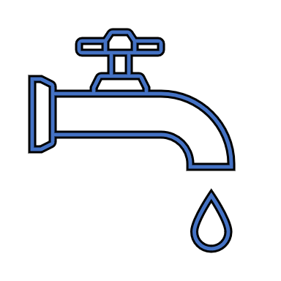
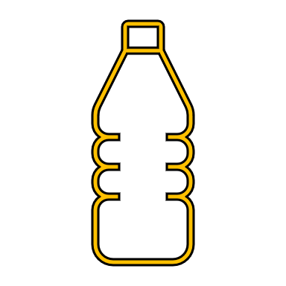
Does bottled water taste better than tap water in Flanders?
Tap water is convenient, safe and cheap
The consumption of bottled water is increasing worldwide
In Flanders, 66% of the participants drink bottled water at least half of the time (research by Flanders Environment Agency) [1]

Slide 3
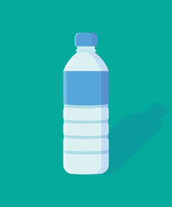
What water can be called bottled mineral water?
Drinking water
By European Community legislation (Directive number 98/38), Drinking water has to be “clear, odorless, tasteless, colorless and harmless, that is devoid of pathogenic microorganisms and harmful chemicals to humans”.
Bottled mineral water
Main Sources: groundwater
Access: Extracted directly from the water source and bottled.
Process: Not undergone any chemical or microbiological treatment
Contents: Is stable and unique, depending on the source and type of rocks it encounters [2].

Slide 4
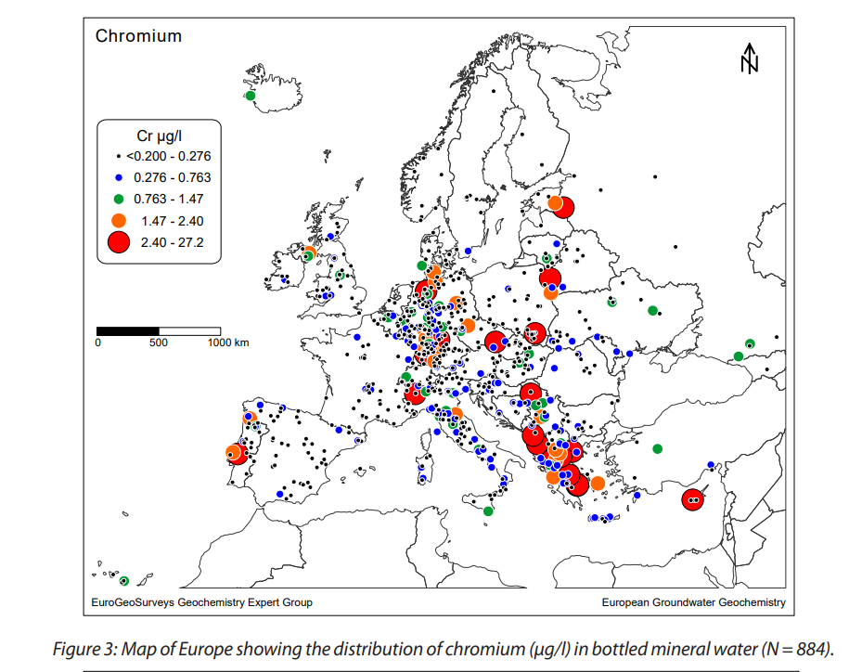
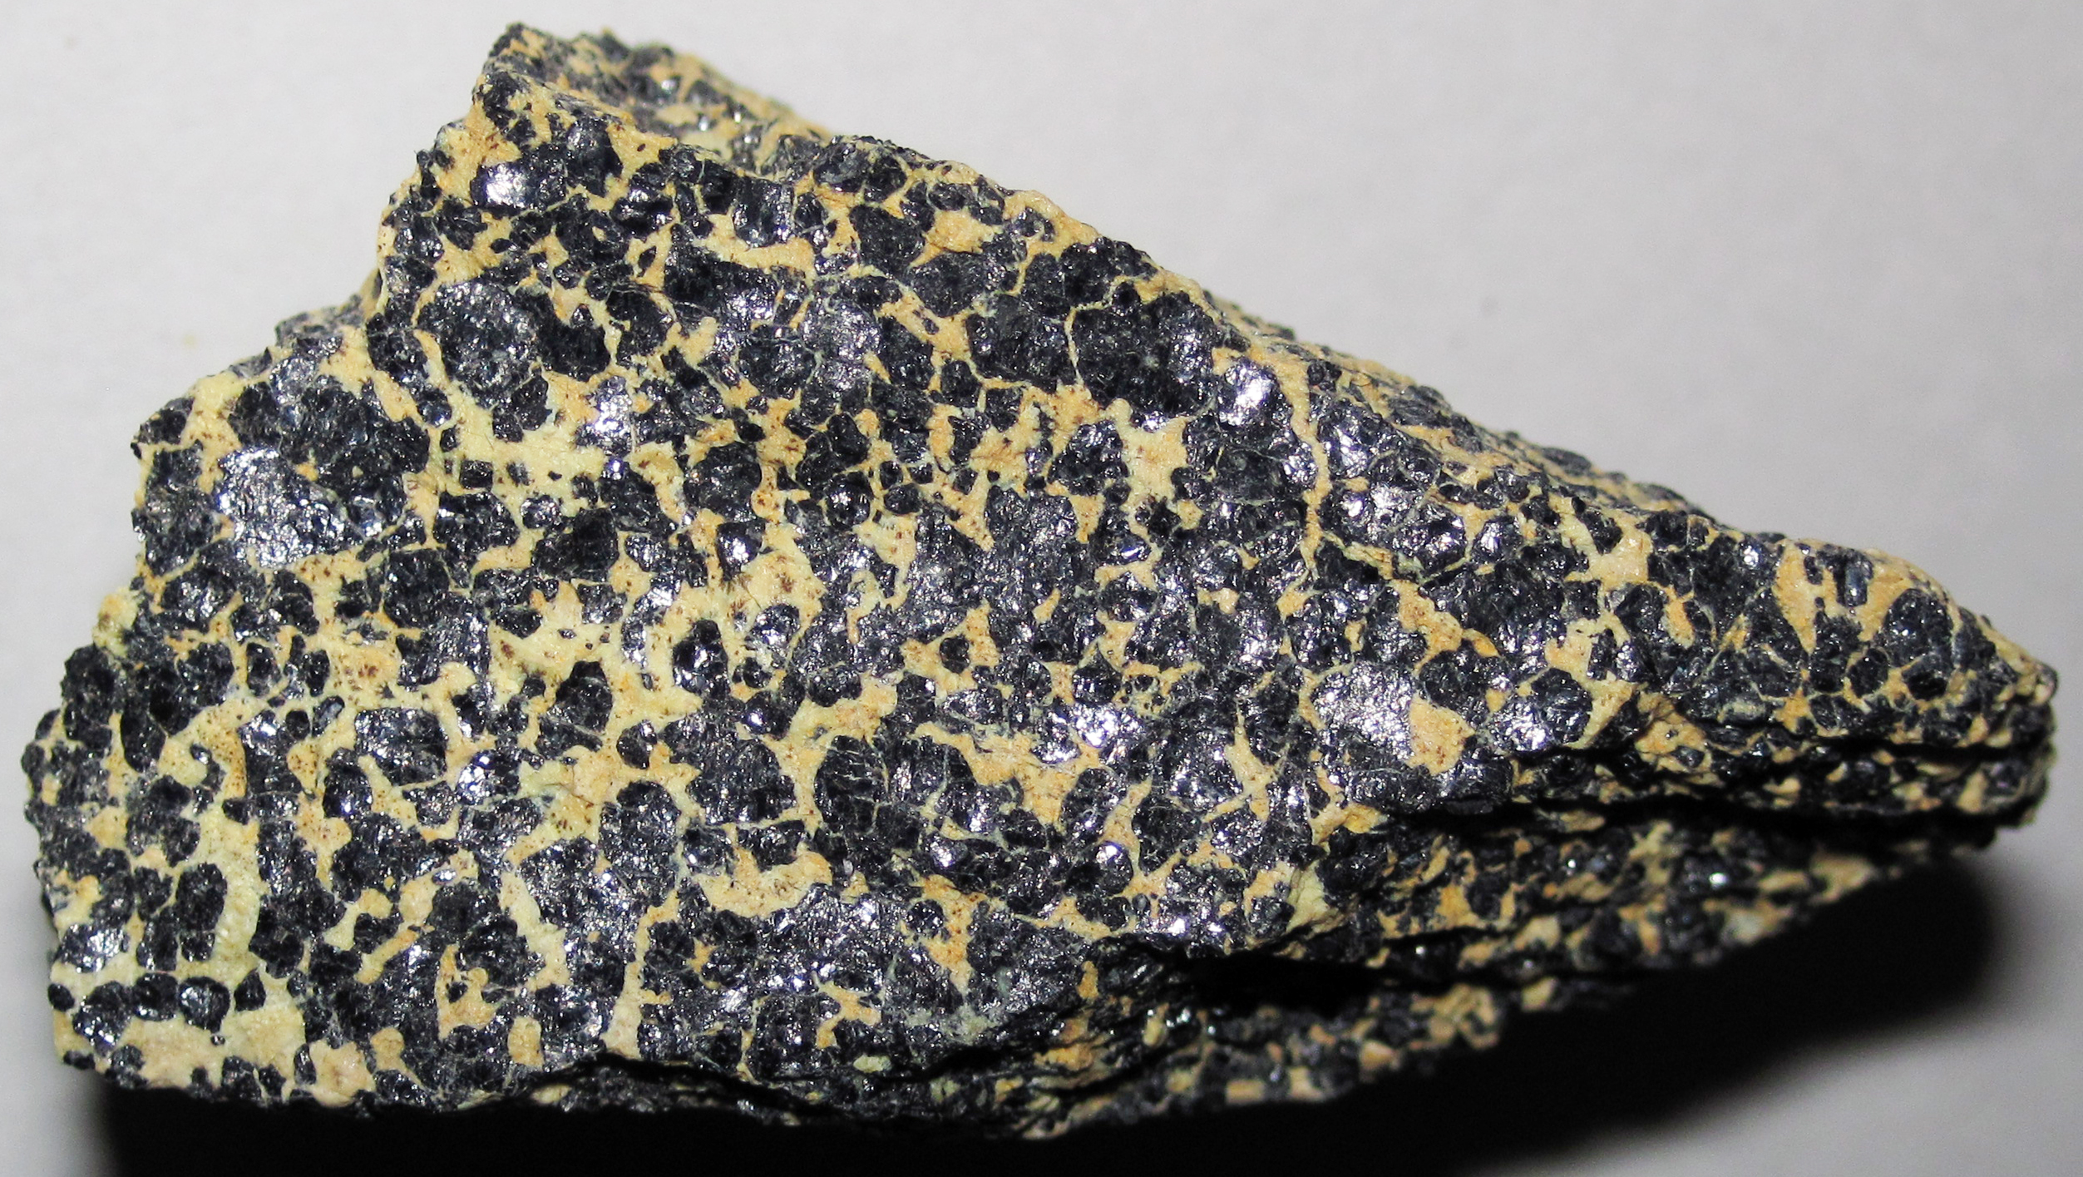
Mineral distribution related to the geological composition
The mineral deposits can be related to specific types of plate-tectonic environments [4]
Europe as a continent, the natural changes in water much greater than other factors
Minerals are regarded as the first impression of groundwater quality change [3]
The main source of bottled water is groundwater, which means it strongly affected by the geological composition
Table 1 – The geological components with high value chemicals [3]
High values chemicals | Geological components
Cr | Ophiolite complexes
Be | Hercynian granite masses
Cs | Hercynian granite masses
Li | Hercynian granite masses
F | Alkaline rocks
K | Alkaline rocks
Si | Alkaline rocks
V | Active volcanism

Slide 5
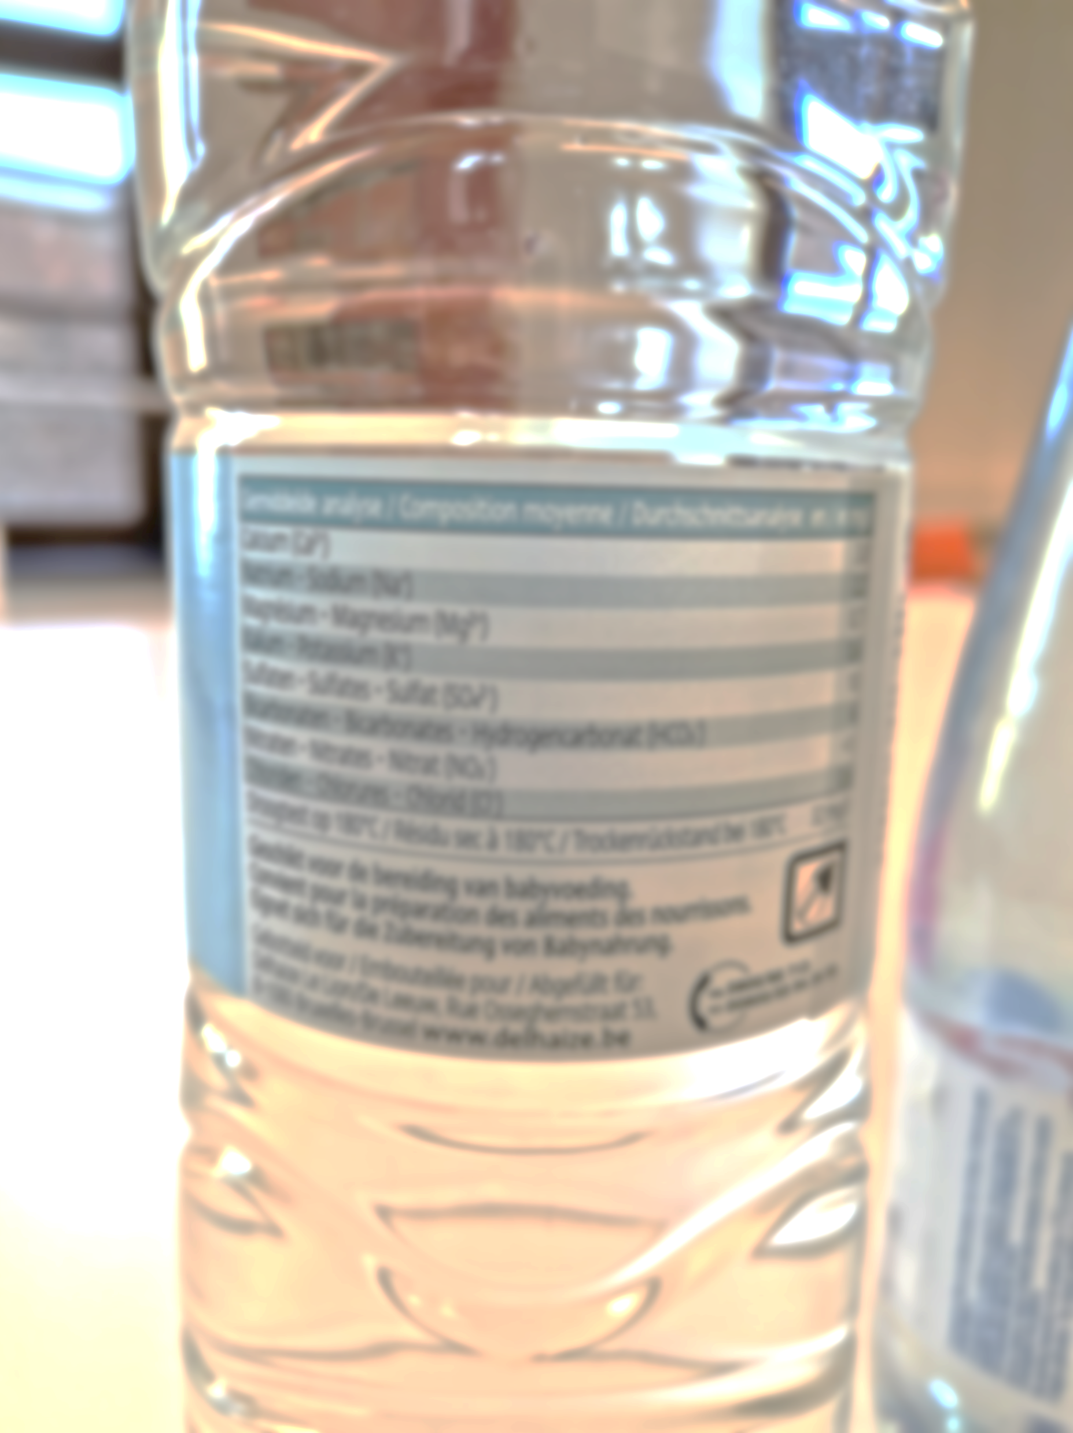
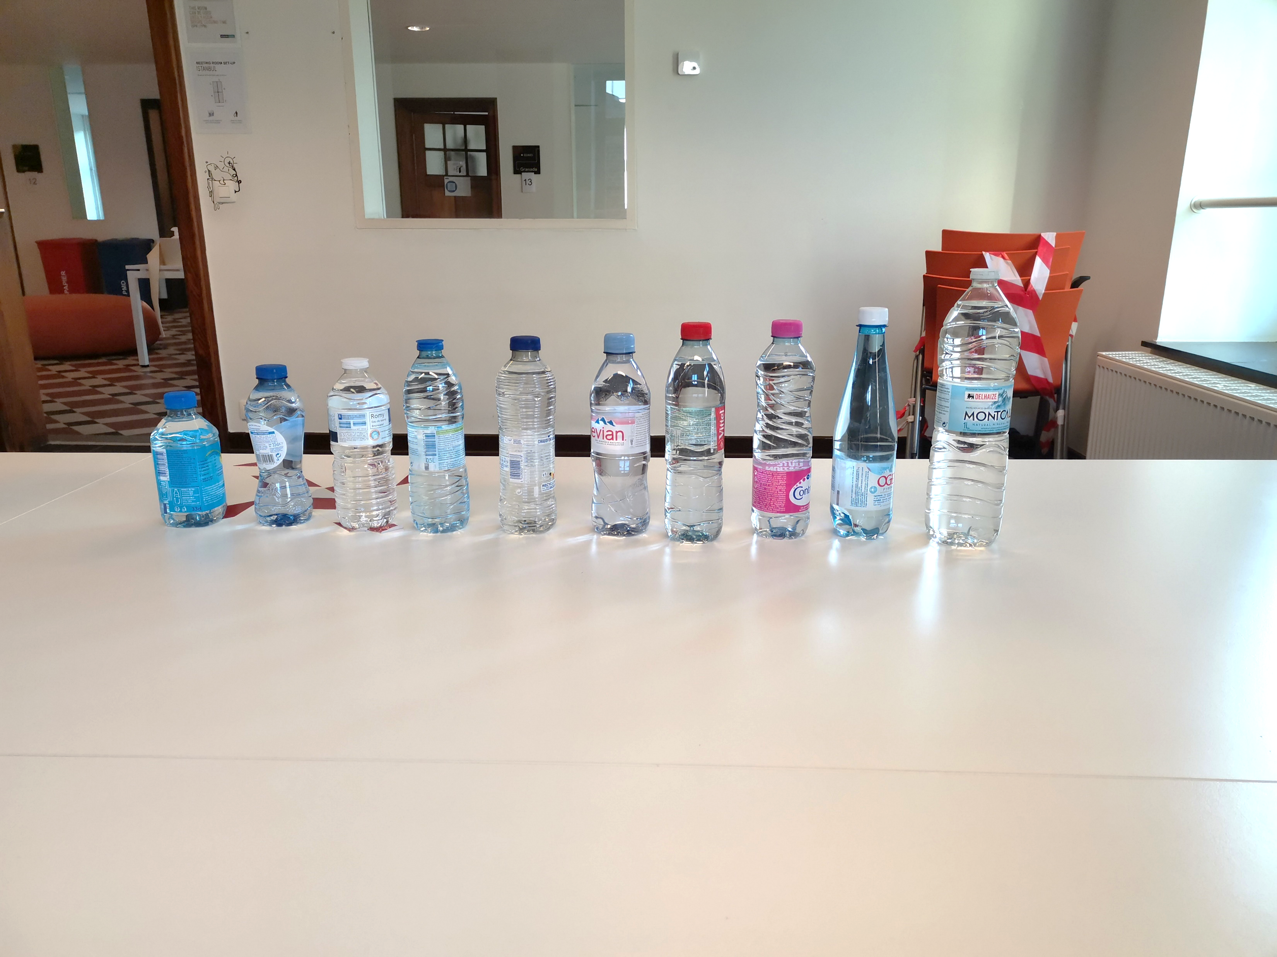
A bottled water Study
Aim: Classify the mineral water and attempt to infer the geological characteristics of the water source through the composition of the element content..[4]
• 21.04.2021
• Delhaize (Leuven) Supermarket
• 10 bottles different brands mineral water
• 330ml-1000ml
• Minerals contents: labels and websites
Info sources: Mineral Water Atlas of the World
http://mineralwaters.geo.uu.nl/world.php

Slide 6
Minerals contents and sources of the study water
Table 2 – Mineral content and water sources of the studied bottled water
NO. | Brand | Minerals (mg/l) |  |  |  |  |  |  |  |  |  |  | Location
 | Brand | Ca²⁺ | Na⁺ | Mg²⁺ | K⁺ | SO4²⁻ | HCO³⁻ | NO³⁻ | Cl⁻ | F⁻ | pH | Residual at 180° | Location
1 | Montcalm | 3 | 2.2 | 0.7 | 0.6 | 10 | 6 | <1 | 0.6 | - | 6.8 | 32 | Ariége region, Pyrenees. France
2 | OGEU | 51 | 31 | 11 | 0.9 | 15.5 | 185 | 5.5 | 46 | <0.2 | 5 | 267 | Pyrenees mountains, France
3 | Contrex | 468 | 9.4 | 74.5 | 3.2 | 1121 | 372 | 2.7 | 10 | - | - | 2078 | Contrexéville, France
4 | Vittel | 240 | 5.2 | 42 | - | 400 | 384 | 4.4 | - | - | - | 1084 | Vittel, France
5 | Evian | 80 | 6.5 | 26 | 1 | 14 | 360 | 3.8 | 10 | - | 7.2 | 345 | Évian-les-Bains, France
6 | Valvert | 67.6 | 1.9 | 2 | 1.7 | 18 | 204 | 4 | 4 | - | 7.3 | 201 | Etalle forest， Belgium
7 | Romy | 104 | 3.7 | 3.7 | - | 52 | 280 | <2 | 4 | - | - | 274 | Jandun, France
8 | Spa | 5 | 3 | 2 | 0.5 | 4 | 17 | 1.5 | 5 | - | 6 | 38 | Reine, Belgium
9 | Hepar | 549 | 14.2 | 119 | - | 1530 | 383.7 | 4.3 | - | - | 7.2 | 2513 | Vosges, France
10 | Chaudfontaine | 65 | 44 | 18 | 2.5 | 40 | 305 | <1 | 35 | 0.4 | 7.6 | 385 | Ardenne Mountain, Belgum
Classification methods for studied mineral water:
a) residual at 180℃ b) pH c) chemical composition

Slide 7
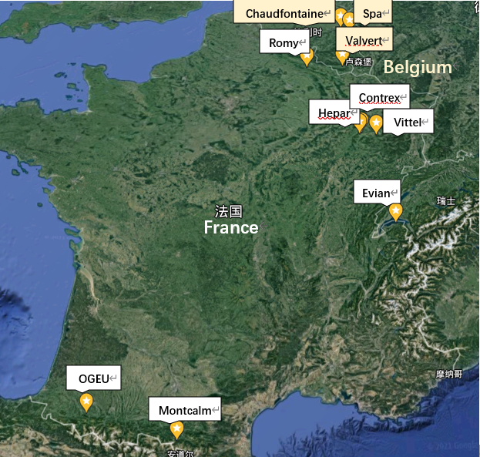
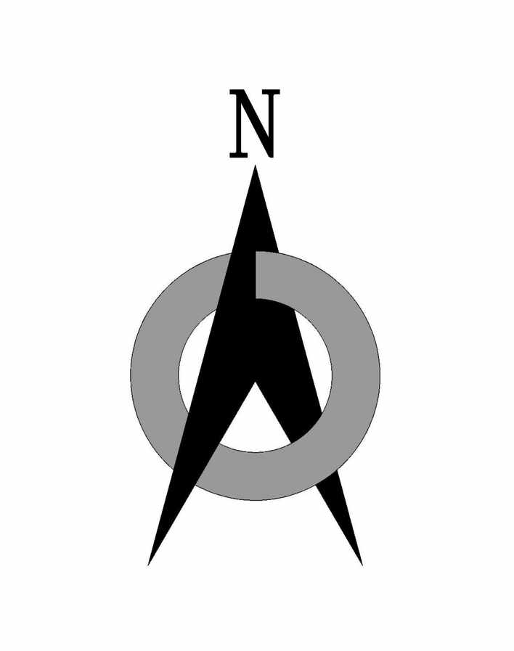
Source distribution of studied bottled water
10 samples, 10 brands, 2 countries
Mainly 4 regions
1) Vosges (France): Hepar, Contex, Vittel
2) Pyrenees (France): OGEU, Montclam
3) Evian-les-Bains (France): Evian
4) French-Belgian border: Chaudfontaine, Spa, Romy, Valvert

Slide 8
The types of rocks that make up different geology
Igneous rocks
Sedimentary rocks
Metamorphic rocks
Igneous rocks are rocks formed by the cooling of magma or lava
Common types: Granite, basalt and andesite.
It is rock particles that accumulated by wind, water, or glaciers in the sand, and gradually accumulated and formed under high-pressure diagenesis, it account approximately 70% of the rocks on the surface
Common types: Limestone and sandstone
Metamorphic rocks are composed of igneous rocks and sedimentary rocks that are extruded and glued under high temperature and high pressure.
Common types: Quartzite

Slide 9
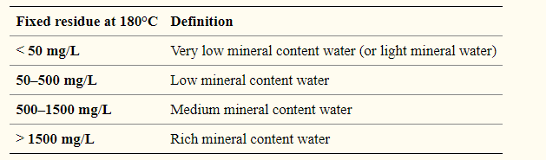
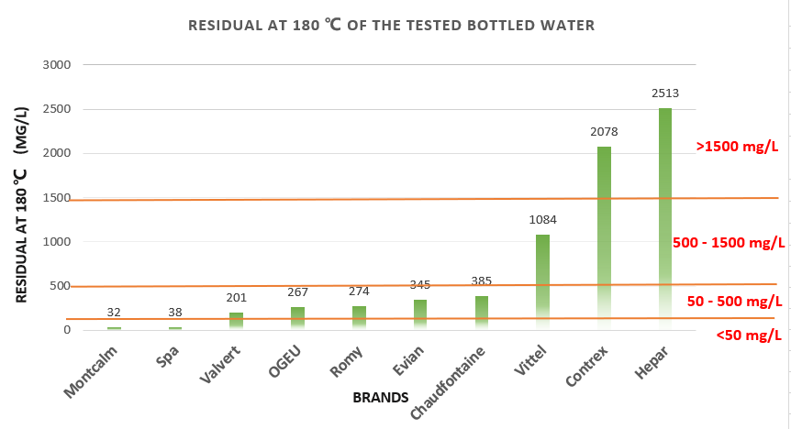
Classification of mineral water - Residual
Table 3 – Classification of natural waters based on fixed residue at 180 ℃ [2]
According to European regulations (2009/54/EC Directive), mineral water is classified using physical and chemical properties. First, natural mineral water is classified by 180℃ fixed residue.
The last 3 brands have medium or rich mineral content all come from the same region – Vosges (France), and the very low mineral contents water comes from Pyrenees mountain (France) and High Fens(Belgium).

Slide 10

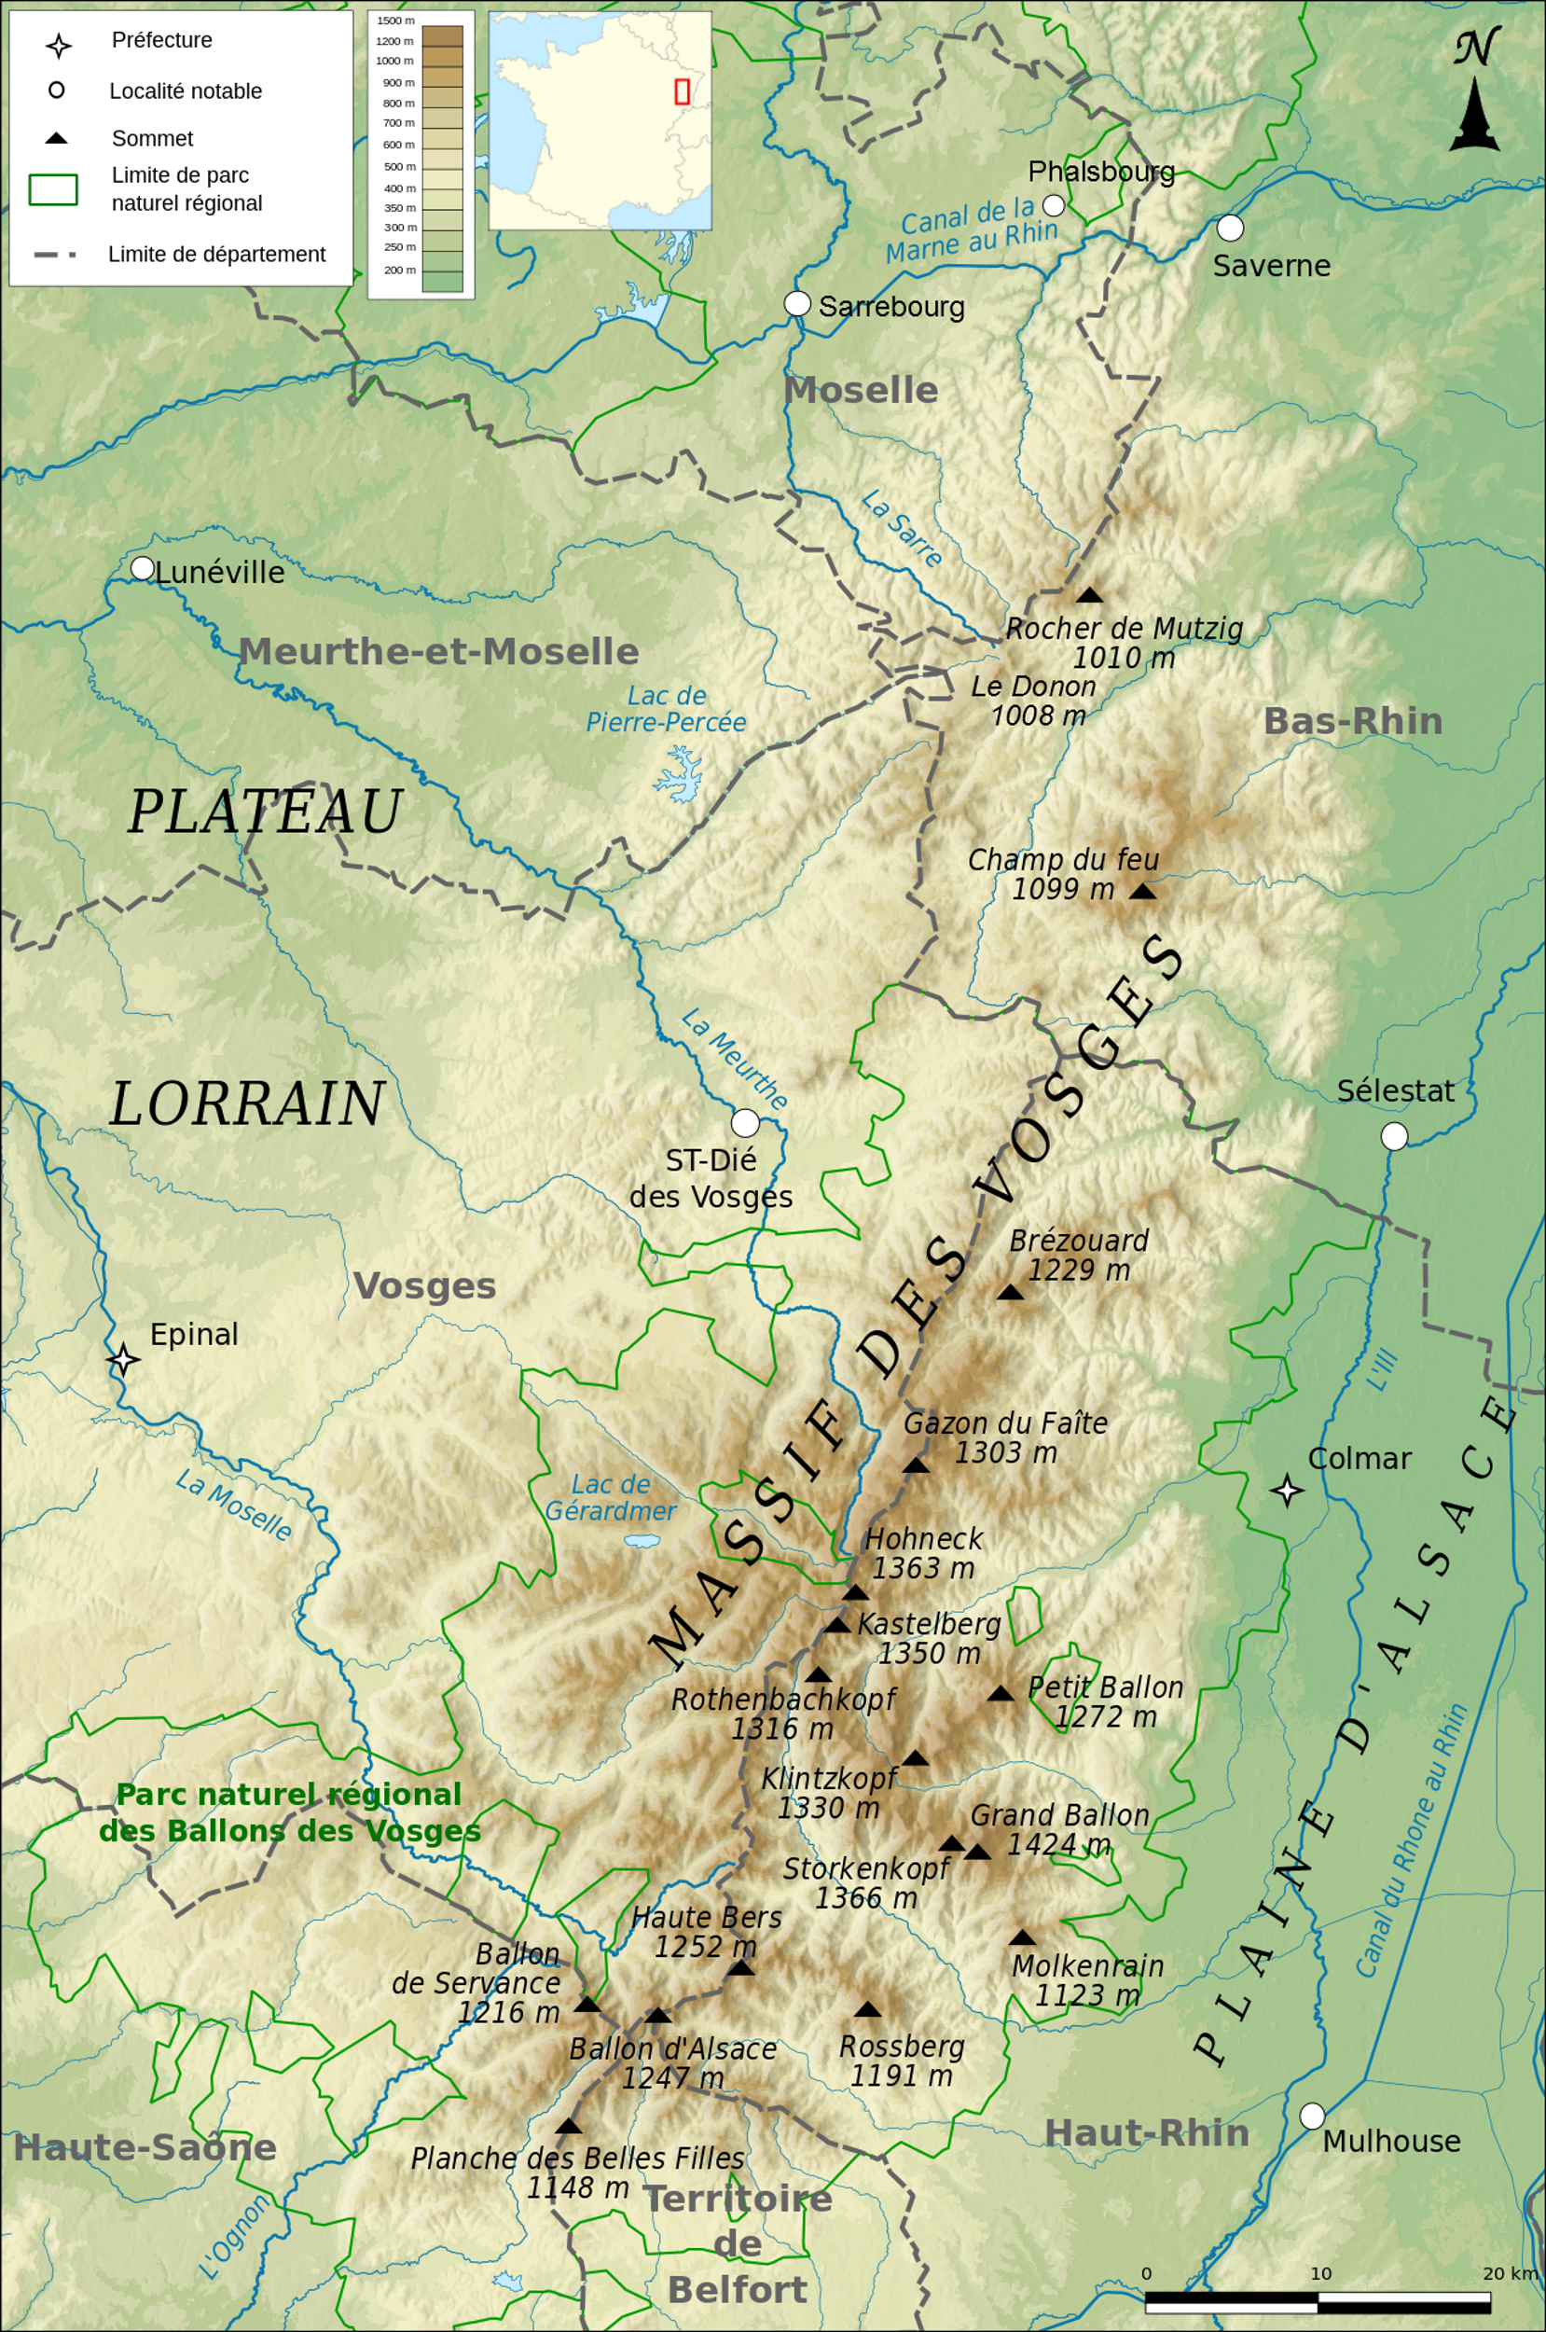
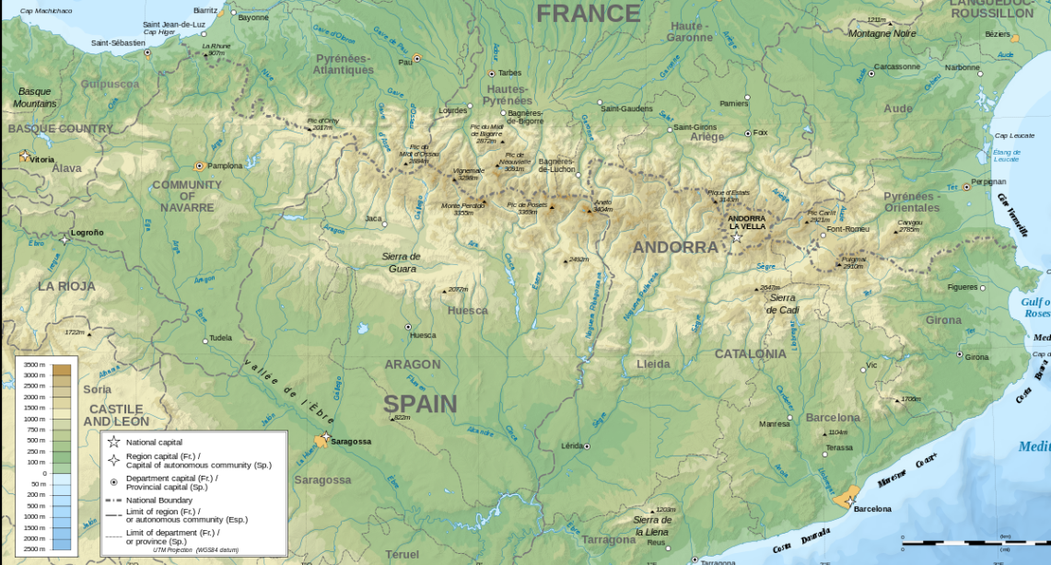
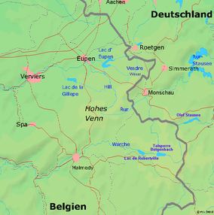

The correlation between elements and geology
Geology plays an important role in determining the types and amounts of minerals in groundwater. [5]
Ca, Mg, Na and K dissolved more rapidly from the carbonate and sedimentary rocks (limestone, sandstone) than unreactive igneous and metamorphic rocks.
The types of rock in Vosges are Mainly composed of sandstone and granite，so it is more susceptible to corrosion and release more minerals into groundwater.[5]
The eastern part of the Pyrenees is mainly composed of granite and gneiss, while the western part of the granite peak is flanked by limestone layers. The granite is particularly resistant to corrosion, so the mineral content in the water in this place is very low.
The composition of the rocks in Hign Fens are quartzite and phyllite, all belong to the metamorphic rocks that has very slow corrosion process.
Map of the High Fens
https://en.wikipedia.org/wiki/High_Fens
Map of the Vosges Mountains
https://en.wikipedia.org/wiki/Vosges
Map of the Pyrenees Mountains
https://en.wikipedia.org/wiki/Pyrenees

Slide 11
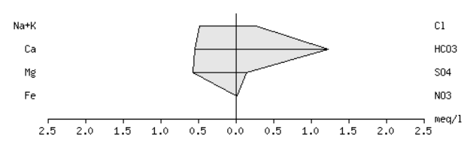
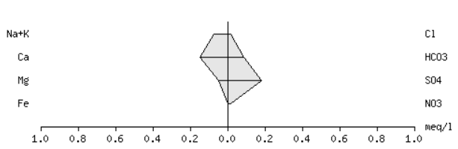
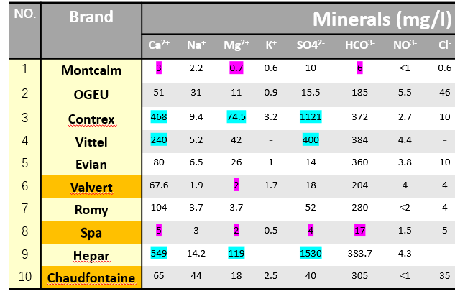
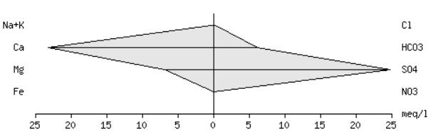
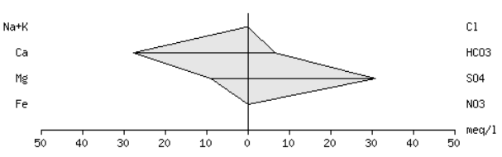
The correlation inter-element
The stiff diagram shows clearly that the Ca2+ and Mg2+ has a strong positive correlation in both the rich and very low residue water sources, besides, sulfate ions also increased with the increase of calcium and magnesium ions in rich residue water.
Spa
Very low mineral content
Stiff diagram
Montclam
Contrex
rich mineral content
Hepper
http://mineralwaters.geo.uu.nl/world.php [6]

Slide 12
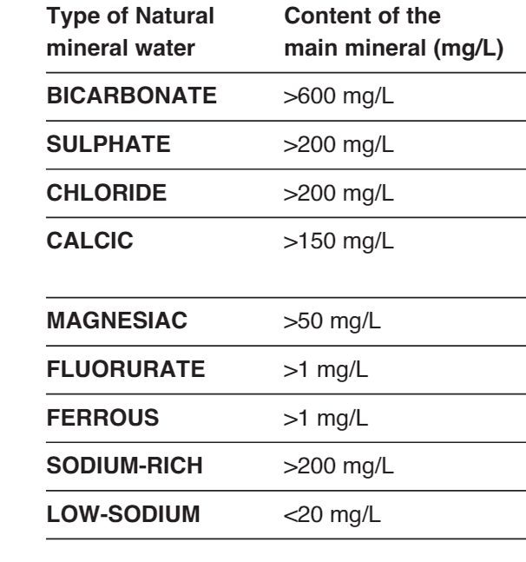
Classification of mineral water – chemical compositions
The bottled mineral waters are grouped by the characteristic chemical elements:
Table 4 – The mineral water groups divided by characteristics of chemicals
Normal ： Without characteristic chemical elements，all of the chemical elements are within the normal range.
Notes:
The bottled mineral water can be divided into different groups which are represented by the characteristic chemical elements. The most common bottled mineral water is the low-sodium. However, the Contrex and Hepar are both the high Calcium water and Magnesium water. The sulphate water only have one fits its standard. The normal water means that we can not use the data on their label to decide their types. For example, the sodium of the OGEU is with the range of too high and low, so the OGEU is neither sodium-high or low-sodium. The criteria for the different types of water are listed in the chart.

Slide 13
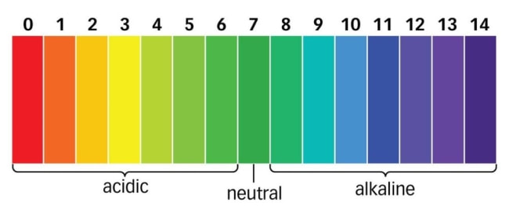
Classification of mineral water - pH
Low pH water may have a bitter or metallic taste;
Water with low pH is often corrosive;
Indicates the presence of acidic waste from mine drainage systems or other sources [7]
The Pyrenees has some favorable lithology and climatic conditions (iron-rich parent material) for the formation of acid sulfate soils (ASS). The low pH may be due to newly formed pyrite or cambros in the soil- Oxidation of the pyrite
OGEU
Spa
Montcalm
Other Brands
Notes:
The pH of water may influence the taste of the drinking water. The most of bottled drinking waters are around 7, but one is about 5 which is possible to taste less sweet than others.
Also, the low pH may leads to a bad influence to the system, as the water with low pH is tend to be corrosive.
The acid substance may come from the drainage system and then lead to a acidic consequence of the water.

Slide 14
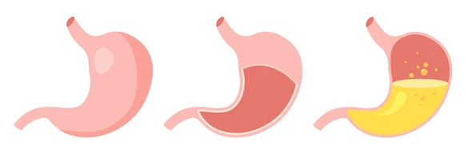
The Health Effects of the different mineral waters
MAGNESIAC, BICARBONATE: Promote digestion;
Contrex, Hepar
CALCIC: Help to prevent osteoporosis and hypertension
Contrex, Vittel，Hepar
SODIUM-RICH: Suggested for intense physical activity;
LOW-SODIUM: Suggested in case of hypertension
Montcalm, Contrex, Vittel, Evian, Valvert …
SULPHATE: Lightly laxative; suggested for hepatobiliary diseases.
Hepar
Notes:
Different types of bottled mineral water have varied health effects, and the effects are mainly determined by the primary or characteristic chemical elements.
The Magnesiac and Bicarbonate water can promote digestion, because they can neutralizes gastric acidity. The sodium is essential in the body's metabolism. While doing sports or other physical activities, we need some sodium supplement and the sodium-rich water is a good choice. Also, frequently drinking the low-sodium water may causes high-blood pressure issues of health. Besides, the sulphate water drinking should also be controlled in case of preventing the related body issues.

Slide 15
Parameters for evaluating the quality of BDW ( Bottled Drinking Water )
The classification of the parameters:
Parameters and substances affect the quality of BDW
pH, EC, TDS, HCO3, F, NO3 and SO4
(2) Macronutrients
Ca, K, Mg and Na
(3) Micronutrients-trace elements
Co, Cr, Cu, Fe, Mo, Se and Zn
(4) Potentially essential elements that have some beneficial health effects
B, Mn, Ni and V
(5) Toxic elements using Inductively coupled plasma-mass spectrometry, ICP-MS
Al, As, Cd, Hg, Pb, Th and U
Only a small part of the elements of the bottled mineral water are labelled
Notes:
The chemical elements may contained in the Bottled Drinking Water are varied a lot, and they can be divided into five groups to memorize easily.
The criteria for evaluating the quality is for better understanding the role that bottled mineral water could play in daily life.
One important criteria is the parameters affecting the quality of BDW. This group are quite basic and common to know. The macronutrients and some of the micronutrients-trace elements also can be seen on the label of the BDW. Some elements have special health benefits on human body and these are extra consideration for choosing bottled water.
However, some toxic elements may enter into the bottled drinking water while transferring the water and storing the water. Since these elements are harmful to our body health, we need paying attention to their concentration in our drinking bottled water.

Slide 16
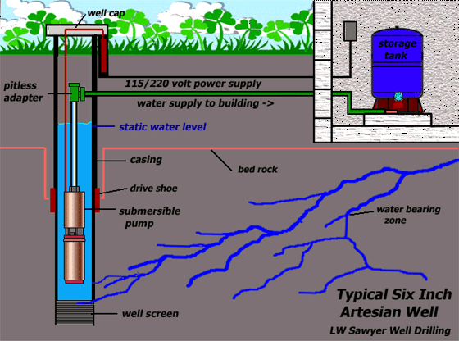
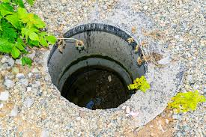
Potential contamination of mineral bottled water
The geochemistry is the main factor for the chemical elements and compounds formation in the bottled mineral water
But from many ways, the contamination could happen and the toxic elements can possibly enter into the water.
The degree of contamination can be different from country to country.
e.g. Well installations, transportation
Notes:
This example shows the detailed process of the contamination may happened in the bottled water. The metallic pipes installed in the pumping system usually diffuse a very small amount of the metallic elements into the water it pumps. This is a possible case of the contamination of the bottled water producing. Even though the mineral water is pumped out quickly, the contamination should also be considered. However, in fact most drinking bottled water are lack of mentioning these chemical concentrations.

Slide 17
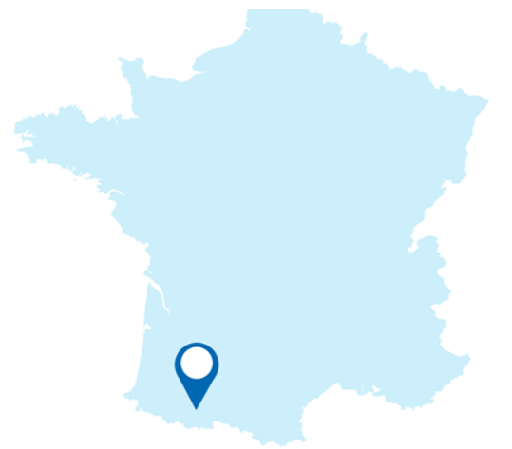
Bottled water VS. Tap water
Therefore, we suggest that tap water can fully meet our daily demand for minerals, and all indicators are within a safe range. If there are special needs for minerals and taste, bottled water can be purchased on demand.
Table 5– Compare the bottled mineral water and tap water in Flanders with standards [10]
Parameters | WHO | USPH | European standard | Present study Bottled water | Heverlee | Roosdaal(Ordal)
Ca²⁺ | 75-200 | 100 | 100 | 3-549 | 125 | 107
Na⁺ | 50-60 | - | - | 1.9-44 | 15.8 | 15
Mg²⁺ | 30-150 | 30 | - | 0.7-119 | 13.4 | 17
K⁺ | 20 | - | - | 0.5-3.2 | 2.6 | 2.5
SO4²⁻ | 200-250 | 250 | - | 4-1530 | 78 | 84
NO³⁻ | 40-50 | - | - | <=5.5 | 31 | 12
Cl⁻ | 200-600 | 250 | 250 | 0.6-46 | 46 | 31
pH | 6.9-9.2 | 6.5-8.5 | 6.0-8.5 | 5-7.6 | - | -
Notes:
Tap water is considered as safe for drinking in many countries as well as the bottled water, but there are still a lot differences between the two types of water. The bottled waters have a large range of many chemical concentration variation. As their distinct geography types in the formation of the bottled water, we can see that the most elements changes in a large scale. However, the tap water parameters for heverlee and roosdaal are more stable.
The bottled waters have a lot of differences and they can not use a certain frame to estimate if we don’t refer to a certain one. Therefore, the bottled water need our attention on their quality more than the surface water.

Slide 18
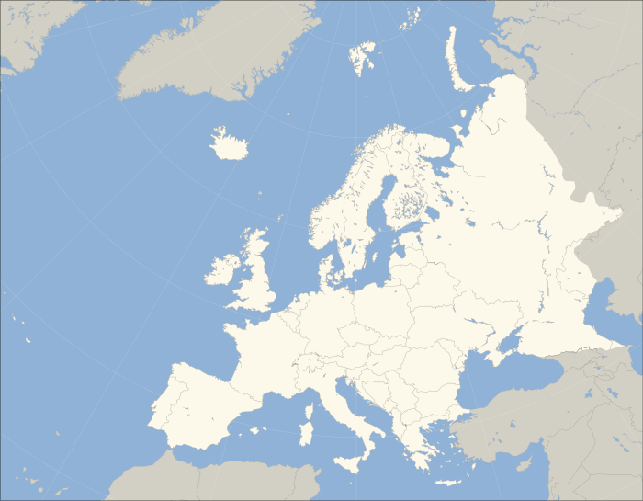
Conclusion
The geological analysis of BMW shows that the geological effect is the main factor for the different types of the related ground water;
The evaluation parameters of BMW and the related chemical elements can be distributed into five groups;
The bottled waters have huge varied range of elements range, while the tap water is more stable.
Notes:
Firstly, The geological analysis of BMW shows that the geological effect is the main factor for the different types of the related ground water;
Then, The evaluation parameters of BMW and the related chemical elements can be distributed into five groups;
Last but not least, The bottled waters have huge varied range of elements range, while the tap water is more stable.

Slide 19
References
[1] R. Geerts et al., “Bottle or tap? Toward an integrated approach to water type consumption,” Water Research, vol. 173, p. 115578, Apr. 2020.
[2] Quattrini S, Pampaloni B, Brandi ML. Natural mineral waters: chemical characteristics and health effects. Clin Cases Miner Bone Metab. 2016;13(3):173-180.
[3] Demetriades A, Cullen K, Reimann C, et al. EGG: European Groundwater Geochemistry[J]. European Geologist European Geologist, 2015: 20.
[4] Bustillo Revuelta M. (2018) Mineral Deposits: Types and Geology. In: Mineral Resources. Springer Textbooks in Earth Sciences, Geography and Environment. Springer, Cham. https://doi.org/10.1007/978-3-319-58760-8_2
[5] Nwankwo, C.B., Hoque, M.A., Islam, M.A. et al. Groundwater Constituents and Trace Elements in the Basement Aquifers of Africa and Sedimentary Aquifers of Asia: Medical Hydrogeology of Drinking Water Minerals and Toxicants. Earth Syst Environ 4, 369–384 (2020)
[6] http://mineralwaters.geo.uu.nl/world.php
[7] https://www.ngwa.org/what-is-groundwater/About-groundwater/dissolved-mineral-sources-and-significance
[8] Heydari, Mohammad & ABBASI, Ali & ROHANI, Seyed & HOSSEINI, Seyed. (2013). Correlation Study and Regression Analysis of Drinking Water Quality in Kashan City, Iran. Walailak Journal of Science and Technology. 10. 315-324. 10.2004/wjst.v10i3.338.
[9] https://www.spa.be/nl/het-spa-water
[10] https://www.dewatergroep.be/nl-be/drinkwater/jouw-drinkwater

Slide 20
Q & A
Find your drinking water sources and quality in Flanders：https://www.dewatergroep.be/nl-be/drinkwater/jouw-drinkwater
Mineral Water Atlas of the World
http://mineralwaters.geo.uu.nl/world.php
zhiqi.wang@vub.be
Jiaru.chang@vub.be

